Slide 1
Feature Extraction and Price Prediction for Mobile Phones
Presented by: Ravalika Organization: NextHikes IT Solutions

Slide 2
Technologies
Python
Pandas
NumPy
Seaborn
Matplotlib
Scikit-learn

Slide 3
Project Objective
Analyze mobile phone features and their relationship with price.
Clean and preprocess the dataset.
Perform Univariate, Bivariate and Multivariate EDA.
Identify the most important features affecting mobile phone prices.
Build a Linear Regression model for price prediction.
Evaluate the model using appropriate performance metrics
The project is designed to understand influential mobile-phone features and build a model that predicts price.

Slide 4
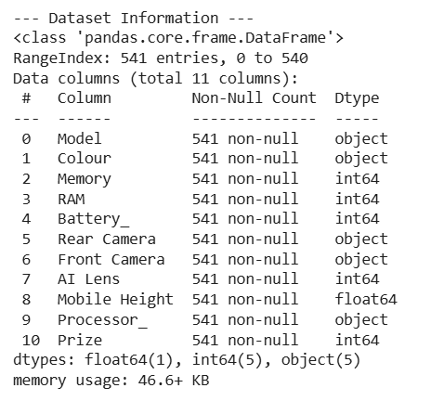
Data Exploration & Preprocessing
Data Exploration:
Loaded the dataset using Pandas.
Removed the unwanted index column.
Checked:
First and last records
Dataset shape
Data types
Statistical summary
Missing values
Duplicate records

Slide 5
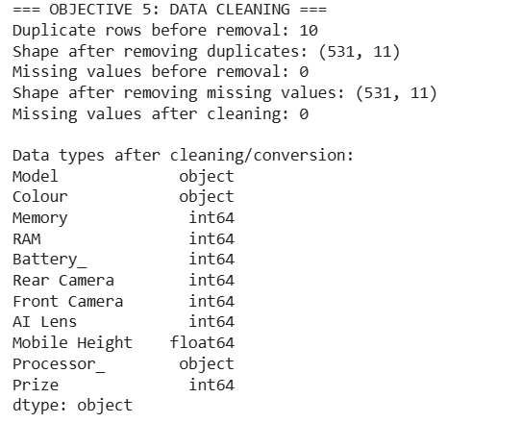
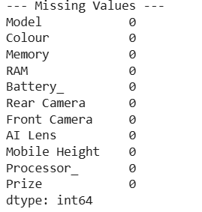
Data Preprocessing:
Removed duplicate and missing records.
Converted camera values such as "12MP" → 12.
Applied One-Hot Encoding to categorical variables such as Model, Colour and Processor.

Slide 6
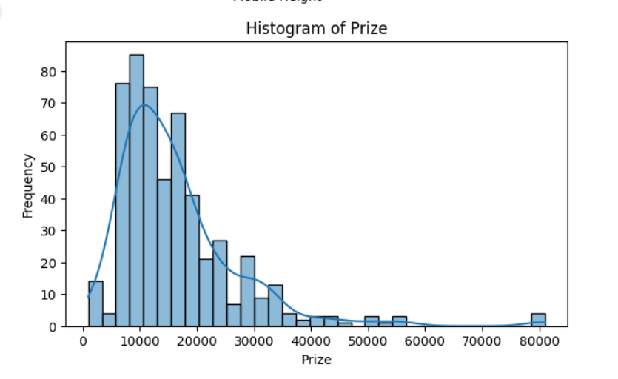
Exploratory Data Analysis(EDA)
EDA was performed using univariate, bivariate, and multivariate analysis to understand data distributions, identify outliers, and study relationships between mobile phone features and price.
Univariate Analysis:
Histograms
Boxplots
Bar charts
Outlier analysis using IQR

Slide 7
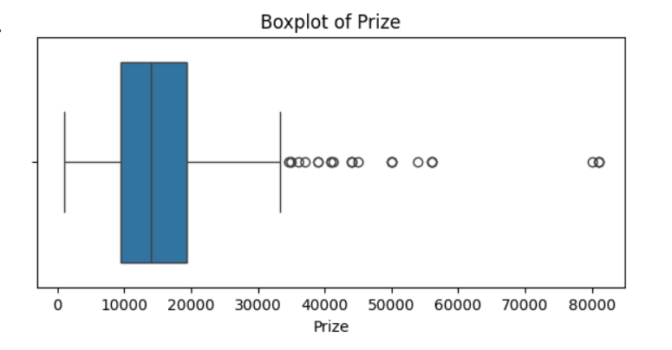
Outlier analysis Prize using IQR
Prize: 25 outliers
Lower limit: -5587.75 Upper limit: 34294.25

Slide 8
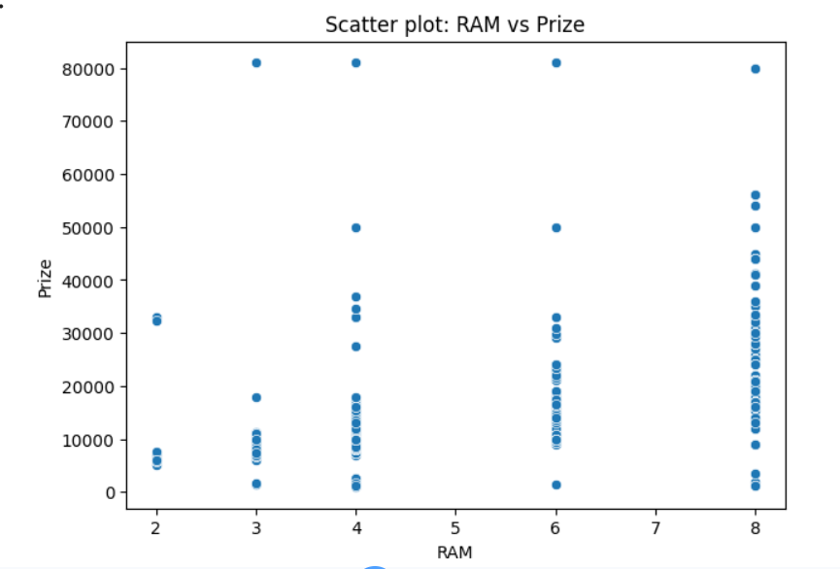
Bivariate Analysis:
Scatter plots
Regression plots
Categorical vs Numerical boxplots
Average-price bar charts
Count plots

Slide 9
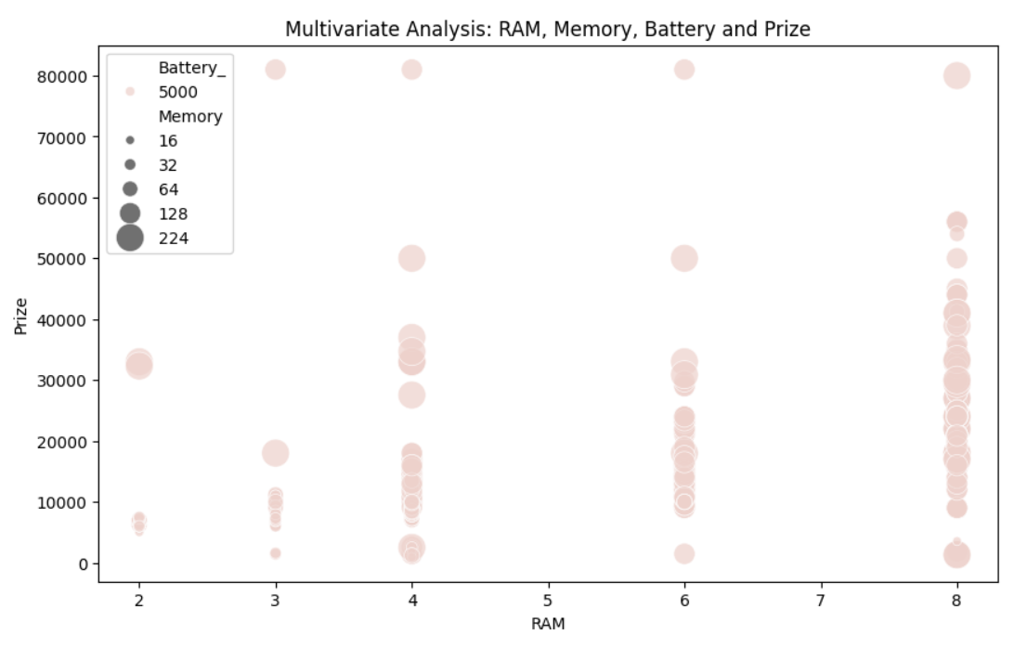
Multivariate Analysis:
Pair plot
Multivariate scatterplot

Slide 10
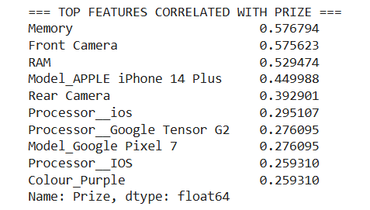
Feature Extraction
Feature Extraction:
Used correlation analysis to identify features related to Prize.
Calculated correlations between numerical features.
Ranked features according to their relationship with price.
Selected the most relevant features for further analysis.
Key Output:
Correlation analysis → Important features → Price prediction

Slide 11
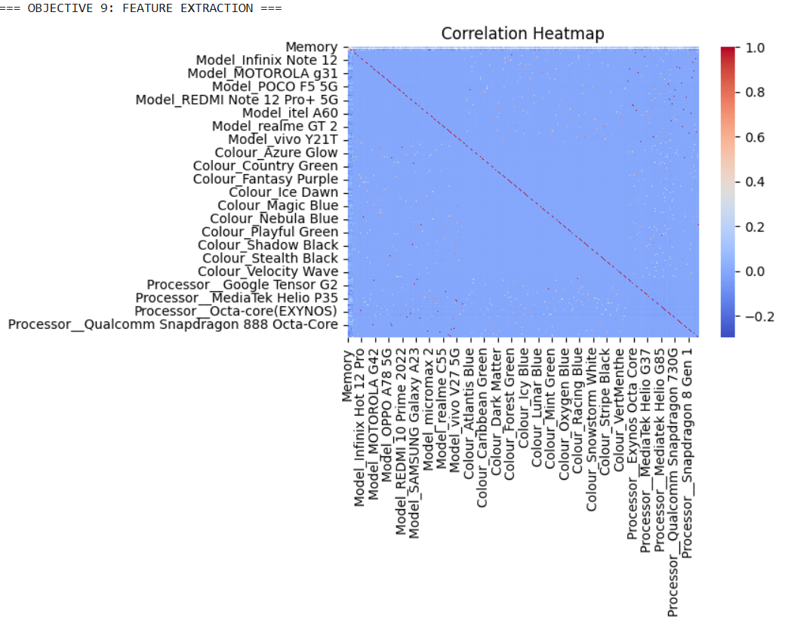

Slide 12
Model Building & Evaluation
Model Building:
Target variable: Prize
Features: remaining mobile-phone attributes
Dataset split into:
80% Training
20% Testing
Algorithm used: Linear Regression
model = LinearRegression()
model.fit(x_train, y_train)
prediction = model.predict(x_test)

Slide 13
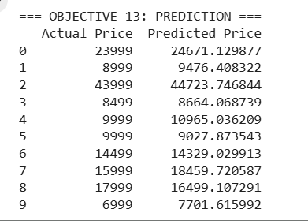
Model Evaluation:
The model was evaluated using:
MAE – Mean Absolute Error:
2708.164081415078
RMSE – Root Mean Squared Error :
7024.1547951248585
R² Score – Measures model fit:
0.5320392126023581(53.2%)

Slide 14
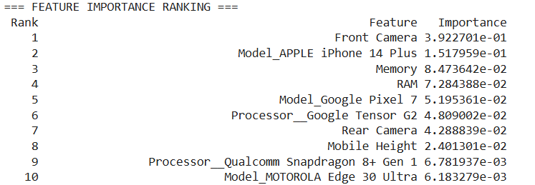
Feature Importance & Conclusion
Feature Importance:
Used Random Forest Regressor to calculate feature importance.
Features were sorted from highest to lowest importance.
Added a Rank column to identify the most influential features.
Top 10 Feature Importance Ranking:

Slide 15
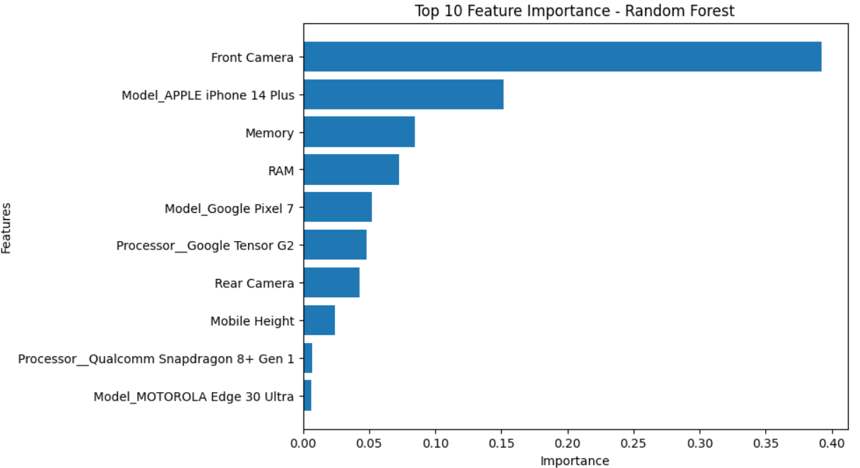

Slide 16
Conclusion
EDA helped identify patterns and relationships in the dataset.
Linear Regression was used for mobile price prediction.
MAE, RMSE and R² were used for evaluation.
Random Forest identified the most influential features.
The analysis provides insights into factors affecting mobile phone prices.

Slide 17
THANK YOU

